Slide 1
First-aid Program
Standard 29 CFR Part 1910.151
Presented by: Barton Insurance Group LLC
© 2010 Zywave, Inc. All right’s reserved.

Slide 2
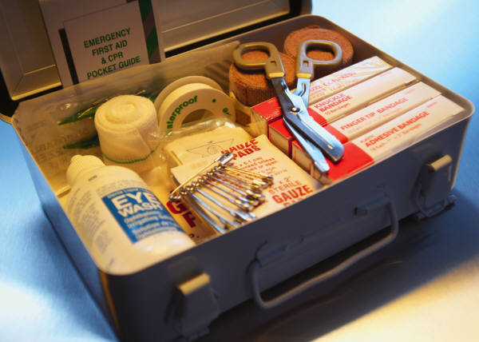
First Aid: Agenda
In today’s session, you’ll be learning about:
What first aid is
Who is authorized to administer first aid
What to do in the event of a medical emergency

Slide 3
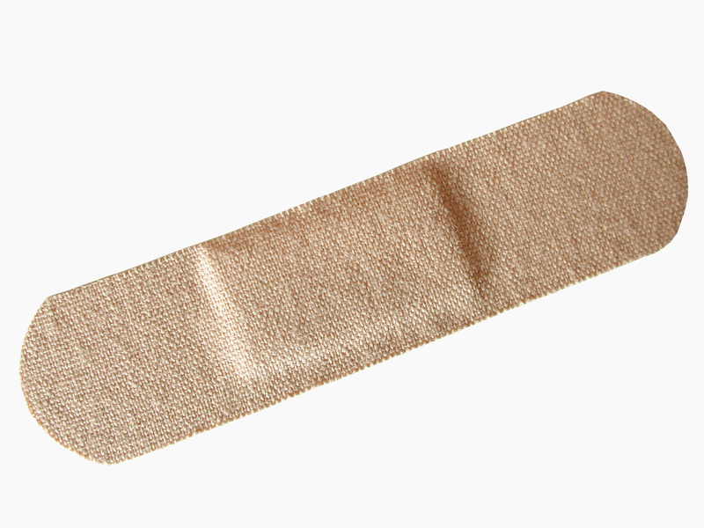
What is first aid?
First aid is emergency care provided for an injury or sudden illness before emergency medical treatment is available.
Examples of first aid include:
Treatment for non-life-threatening emergencies, including burns, eye injuries and wounds
Treatment for life-threatening emergencies, including poisoning, asphyxiation, seizures

Slide 4
Why is this important to me?
Prompt and knowledgeable treatment can prevent minor injuries from becoming major. It is important that every employee knows:
Which employees are trained and authorized to administer first aid and how to reach them quickly
and
What to do and what not to do in the event of a medical emergency

Slide 5
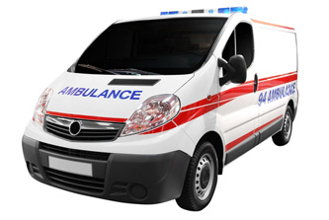
Calling an Ambulance
In some cases, a sick or injured worker may be taken to a medical facility by car, but many times an ambulance is necessary. Always call an ambulance when:
The employee is unconscious or in shock
There is hemorrhaging
There are severe abdominal cramps and/or vomiting
There is an apparent fracture
There are other symptoms of internal injury

Slide 6
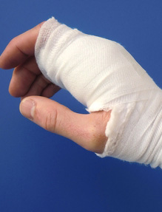
What if I Get Hurt?
If you become ill or injured:
Take it seriously.
Contact your supervisor or other personnel trained in first aid.
Fully document the injury.
Could help to avoid future injuries
NEVER drive yourself to a medical facility.

Slide 7
What if Someone Else Gets Hurt?
When a co-worker is ill or injured, take the following action to ensure their and your safety:
Notify a member of management
Do not move the ill or injured person
Avoid contact with blood or other bodily fluids
If you are calm, stay with the person to provide comfort
If directed by your supervisor, wait for EMS responders at the entrance and direct them to the scene of the emergency
If you are not involved, clear the area

Slide 8
Eyewash Stations and Showers
If you are exposed to chemicals, the first 10 to 15 seconds are very important in preventing serious injury.
Emergency eyewash stations and emergency showers are located:
[INSERT LOCATIONS]
Wash for a minimum of 15 minutes
Alert a supervisor to your injury
Quickly remove contact lenses prior to flushing eyes

Slide 9
Conclusion
What should you keep in mind from today’s presentation?
Know the locations of first aid kits
Know who has been trained as a first responder
Follow Evolution Maintenance, Inc procedures for injury reporting and treatment

Slide 10
For More Information
If you are in doubt about any part of the First Aid Program at Evolution Maintenance, Inc, do not hesitate to contact your supervisor.
This presentation has been brought to you by:
Barton Insurance Group LLC
www.bartoninsurancegroupllc.com
615.806.1265

